Slide 1
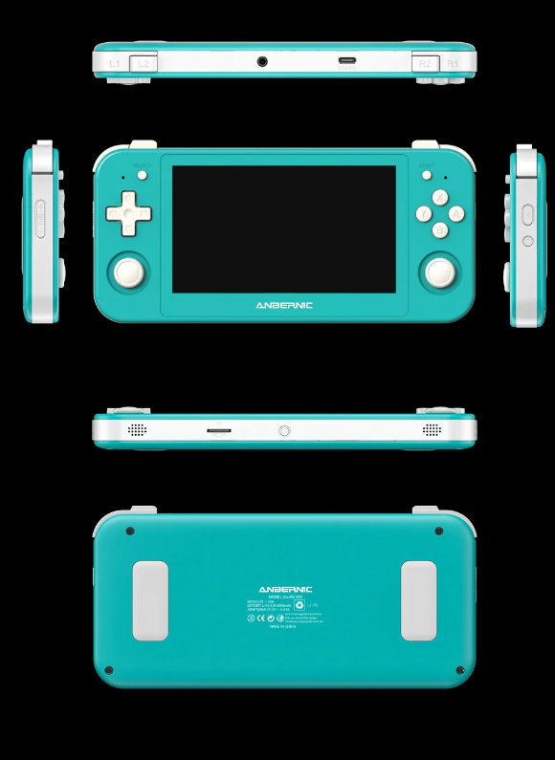
A Portable Playstation in Your Pocket: Enjoy the Gaming Sessions
Handheld pocket video games have been one of the foremost in the gaming industry. Its main appeal lies in its portability, which allows gamers to enjoy their games in one go. Games such as anbernic rg505, a game produced by an Australian gaming company, Pocket Games, are some of the best handheld games available in the market. Let's take a quick preview of handheld games and consoles in this article.

Slide 2
An Overview
Handheld video games are designed to meet all the requirements and needs of gamers, similar to PlayStation. These devices offer portability, convenience, and a whole lot of gaming thrills and experiences just inside their pockets. The companies and the manufacturers are careful and determined enough to create and craft the games up to the mark. They ensure total customer satisfaction by providing high-quality games. Different kinds of features and variations are added to the games, maintaining a high performance.
Gaming devices have revolutionized over the years, from the early days of pixelated screens to today's handheld gaming devices and consoles. These technological advancements have impacted the gaming culture significantly.

Slide 3
Portability is the Key
A portable device that provides all the features of a big PlayStation and gives nearly the same amount of stimulation to gamers is a game changer for handheld consoles. The mobility gives handheld video games an upper hand over any PlayStation. Handheld games are simulatory devices that provide a similar experience.
The flexibility allows the gamers to stay connected with their favorite games and characters anywhere they go; it is just a pocket away. The accessibility of simply slipping your hands into your pocket and playing video games makes it more desirable and appealing.

Slide 4
Things To Know About Handheld Games
All over this time, handheld video games have become popular and iconic. To name a few, one of the earliest is Nintendo's Game Boy, pokemon, and Super Mario. These games were the root cause of the games falling in love with video games.
Since the early days of gaming devices, devices such as Nintendo DS and PlayStation Portable (PSP) have made their mark. In modern days, handheld devices such as anbernic rg505, anbernic rg35 xxplus, Steam DECK OLED, etc., are making their mark in the gaming industry. Each brings something new to the table, such as high-quality graphics, touch controls and panels, screen quality, and connectivity.
Source URL: https://thegeneralpost.com/a-portable-playstation-in-your-pocket-enjoy-the-gaming-sessions/

Slide 5
Thank You
Address: Sydney, NSW, Australia
Email ID: Sales@pocketgames.com.au
Website: https://pocketgames.com.au/

