Slide 1
Appeal in Criminal Cases
Appeal lawyer

Slide 2
Introduction to Criminal Appeals
Definition of a criminal appeal
Purpose of filing an appeal
Differences between trial and appeal
Trial: Determination of guilt or innocence
Appeal: Review of legal errors in trial

Slide 3
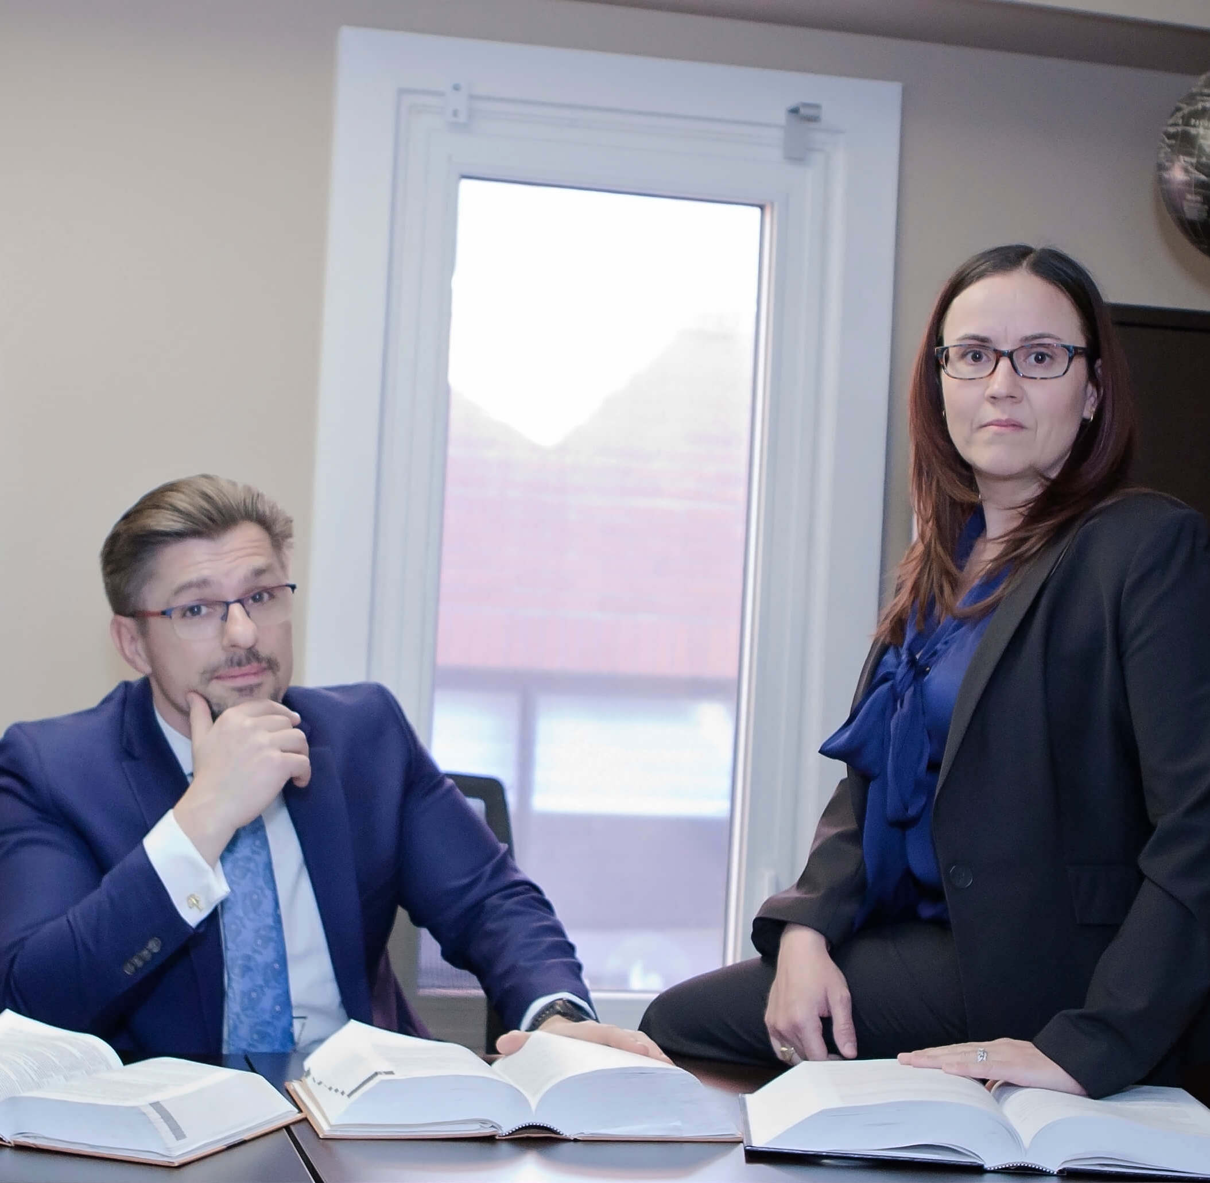
Common Grounds for Criminal Appeals
Legal errors
Misinterpretation of the law
Incorrect jury instructions
Procedural errors
Improper admission/exclusion of evidence
Lack of sufficient evidence
Constitutional violations
Ineffective assistance of counsel
Violation of rights (e.g., Fourth Amendment)

Slide 4
Steps in the Criminal Appeal Process
Filing the notice of appeal
Preparing the appellate brief
Oral arguments
Decision by the appellate court
Possible outcomes
Affirmation of conviction
Reversal of conviction
Remand for a new trial

Slide 5
Role of a Criminal Defense Attorney
Advocates for the defendant's rights
Analyzes trial records for errors
Prepares and submits the appellate brief
Presents oral arguments
Negotiates possible plea deals during appeals

Slide 6
Skills and Expertise of a Criminal Defense Attorney
In-depth knowledge of criminal law and appellate procedures
Strong research and writing skills
Persuasive oral advocacy
Critical thinking and analytical skills
Ability to identify and articulate legal errors

Slide 7
Challenges Faced by Criminal Defense Attorneys
Limited time frames for filing appeals
High standards of review (harmless error vs. reversible error)
Overcoming trial court's deference
Balancing multiple cases and workloads

Slide 8
Case Study: Successful Appeal
Brief overview of a landmark case
Legal errors identified
Role of the defense attorney
Outcome and its implications

Slide 9
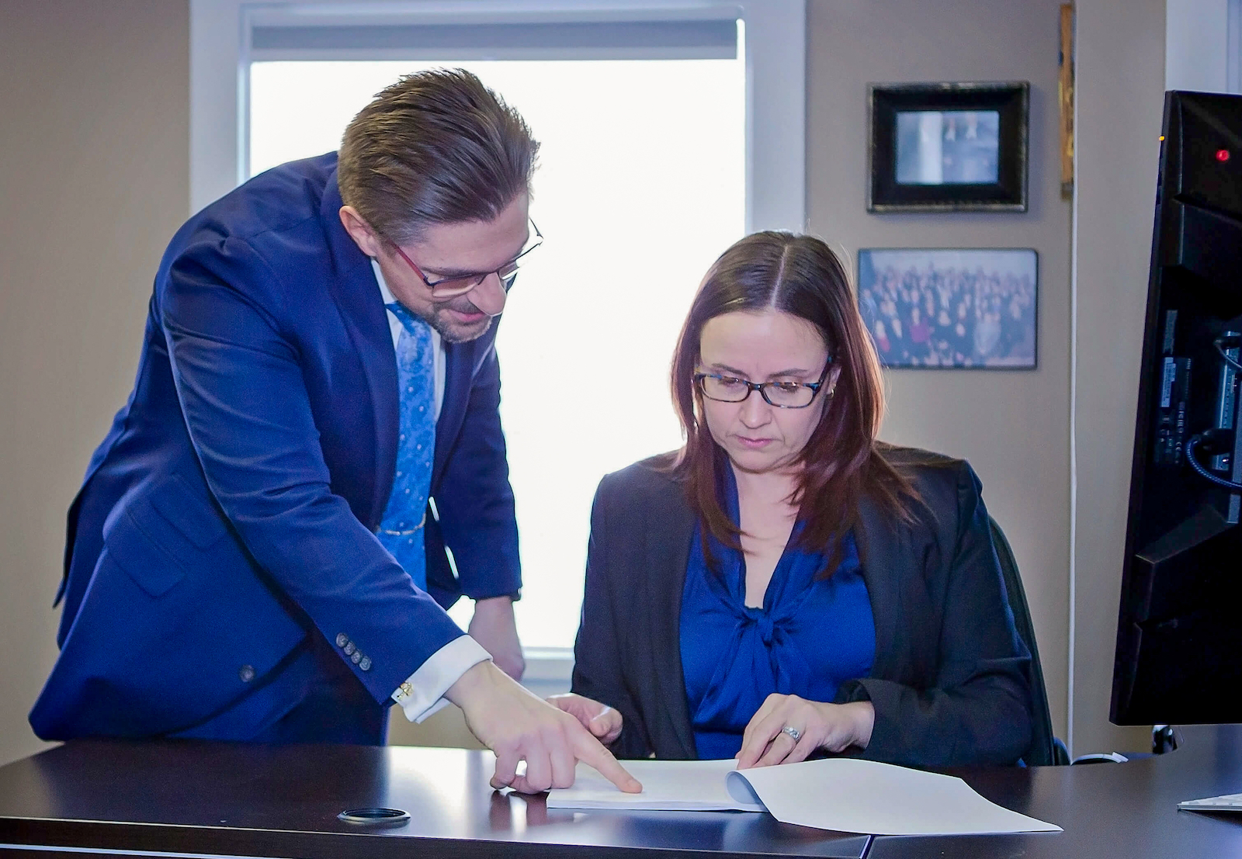
Questions & Discussion
Invite questions from the audience
Encourage discussion on topics covered

Slide 10
Conclusion
Recap of the importance of criminal appeals
The critical role of a criminal defense attorney
The impact of appeals on the justice system
(403) 262-1110
melanie@yycdefence.ca
https://appeallawyer.ca/
https://www.facebook.com/SitarMilczarek
https://x.com/YYCDefence
https://www.linkedin.com/company/sitar-and-milczarek/

