Slide 1

















Slide 2

About them
As a reliable name in vehicle inspection services, One of the Best Vehicle Inspections in the Industry has made a reputation for itself. With a great deal of experience and thorough training, their team of licensed technicians provides clients with a service that gives them confidence and peace of mind. What distinguishes them is their unwavering commitment to objectivity: they only concentrate on honest and open inspections, avoiding delving into auto repairs, so each customer receives an objective evaluation.

Slide 3
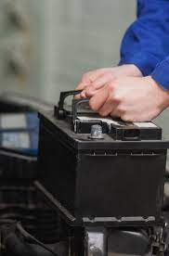
BUSINESS
Ensure uninterrupted operations and prioritize your employees' safety by maintaining the safety and upkeep of your vehicles. Their top-tier Fleet maintenance service is tailored to provide unparalleled reliability in the industry. With them, alleviate the burden of vehicle maintenance from your concerns. Allow their expertise to handle it seamlessly for you.

Slide 4
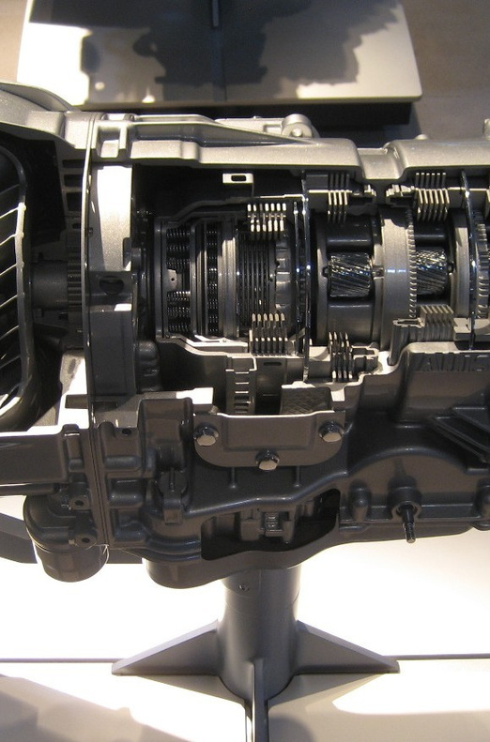
WARRANTY PROTECTION
Why settle for safety compromises or the inconvenience of unexpected breakdowns? Emphasizing routine maintenance prevents such scenarios and identifies possible problems before they escalate into costly or unsafe situations. This proactive strategy not only prolongs your vehicle's lifespan but also guarantees that maintenance aligns with the manufacturer's warranty specifications.

Slide 5
CONTACT THEM
E-mail
calgary@inspectacar.ca
Website
https://inspectacar.ca/
Phone
403-266-5588
Address
542 38A Ave S.E.Calgary South, AB.

