Slide 1




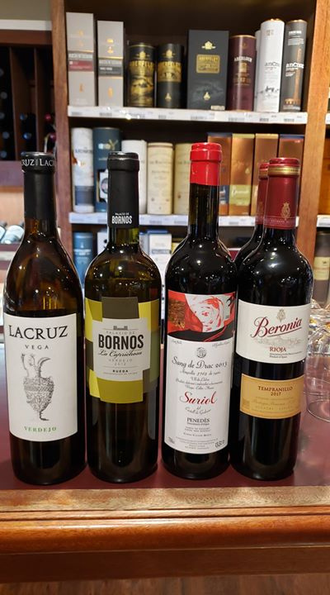




ANDREW HILTON WINE & SPIRITS

Slide 2


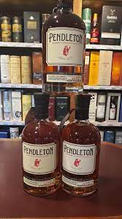


INTRODUCTION
Serving the affluent customers of Southern Alberta, Andrew Hilton Wine & Spirits is a well-known Lethbridge destination for great wine and liquor. They cater to a wide range of tastes with their extensive assortment of premium craft beers, single malt scotches, Growler Fills, and other excellent alcoholic beverages.

Slide 3



HISTORY
When it comes to great wines and beers in Southern Alberta, Andrew Hilton Wine & Spirits has been the go-to option for over thirty years. Not only do they have one of the biggest and most respected wine collections in the area, but they also work hard to create a warm, entertaining, and educational environment. Discover a carefully chosen assortment of drinks designed to enhance any special occasion and fit your personal preferences.

Slide 4

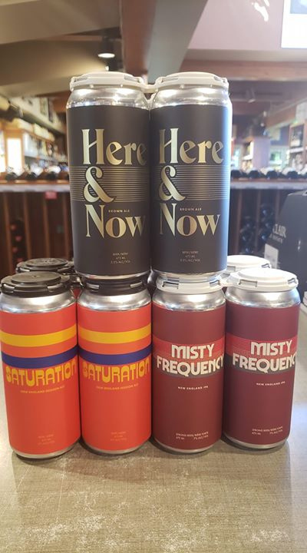
WIDE COLLECTION
At Andrew Hilton Wine & Spirits, you'll find Southern Alberta's premier and extensive wine assortment designed to suit diverse preferences. Their collection includes exceptional wines alongside a carefully curetted selection of craft beers, inviting beer aficionados to explore top-tier options. Supported by a knowledgeable staff, they guarantee a pleasant and informative experience, guiding visitors to uncover the ideal wine or beer choice

Slide 5

THANK YOU SO MUCH
Phone: 403-320-9464
Fax: 403-320-9157
212 - 3rd Avenue South
Lethbridge, Alberta
T1J 0G9
Email: andrewhwine@gmail.com

