Slide 1



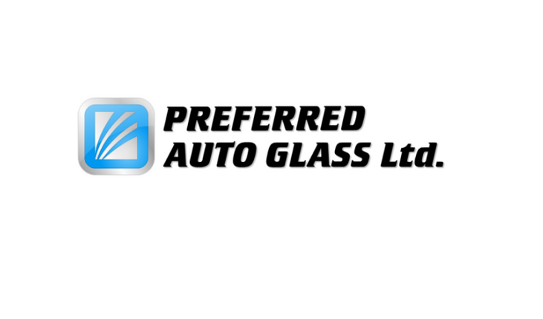
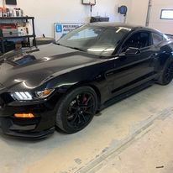


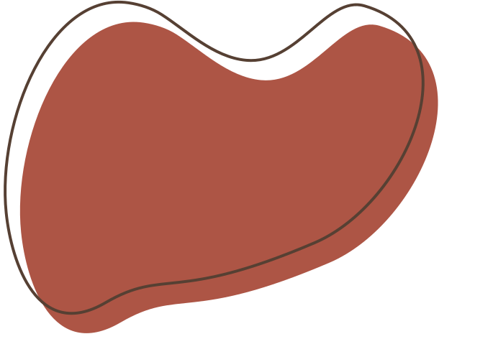
PREFERRED AUTO GLASS

Slide 2




Introduction
Preferred Auto Glass is unwavering in its commitment to guaranteeing the maximum degree of client satisfaction. Their use of premium materials, rapid on-site auto glass replacement or repair, and unparalleled artistry demonstrate their commitment. With a solid reputation for excellence and a deep commitment to meeting customer needs, Preferred Auto Glass guarantees each and every customer a smooth and satisfying experience.

Slide 3
MOBILE SERVICES
Preferred Auto Glass recognizes the hassle and time-consuming nature associated with repairing or replacing auto glass for vehicles.
WARRANTY INFORMATION
ROCK CHIP REPAIR
It's crucial to promptly address the issue at hand. Taking immediate action when handling a minor chip is essential.
The warranty covers all Bonded Glass components, with exceptions for damages resulting from vandalism, theft, natural disasters, owner negligence, or self-inflicted harm. This ensures coverage for specified parts while delineating clear exceptions.

Slide 4
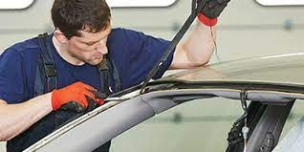
INSURANCE CLAIMS
They work in partnership with a wide range of insurance companies, extending their services beyond the province to streamline and accelerate the claims process. Simply get in touch, provide your vehicle details and claim number, and they'll take care of the entire process, reducing inconvenience and guaranteeing a prompt resolution

Slide 5






Preferred Auto Glass Ltd.
4617-24 Ave South
Lethbridge, Alberta T1K-7C1
Telephone: 403-359-4074
E-mail: info@preferredautoglass.ca
Website: www.preferredautoglass.ca

