Slide 1
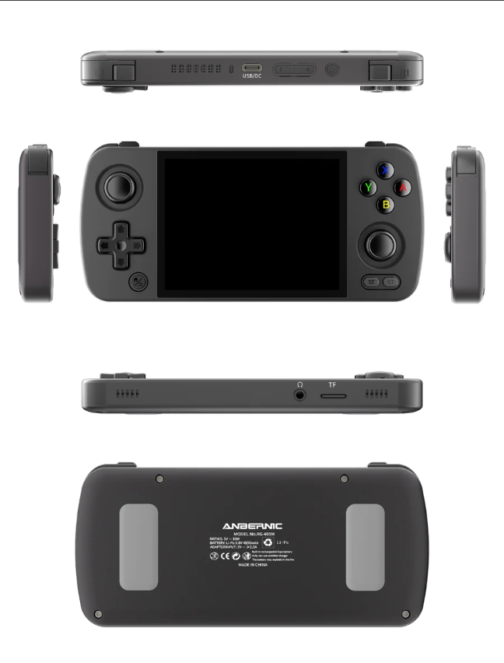
Discover Anbernic RG405M: The Ideal Retro Gaming Console
The Anbernic RG405M truly has a unique blend of features and performance that appeal to enthusiasts and casual gamers alike, making it stand out in the crowded market of retro handheld gaming consoles.
Here are four reasons to choose the RG405M over other options:

Slide 2
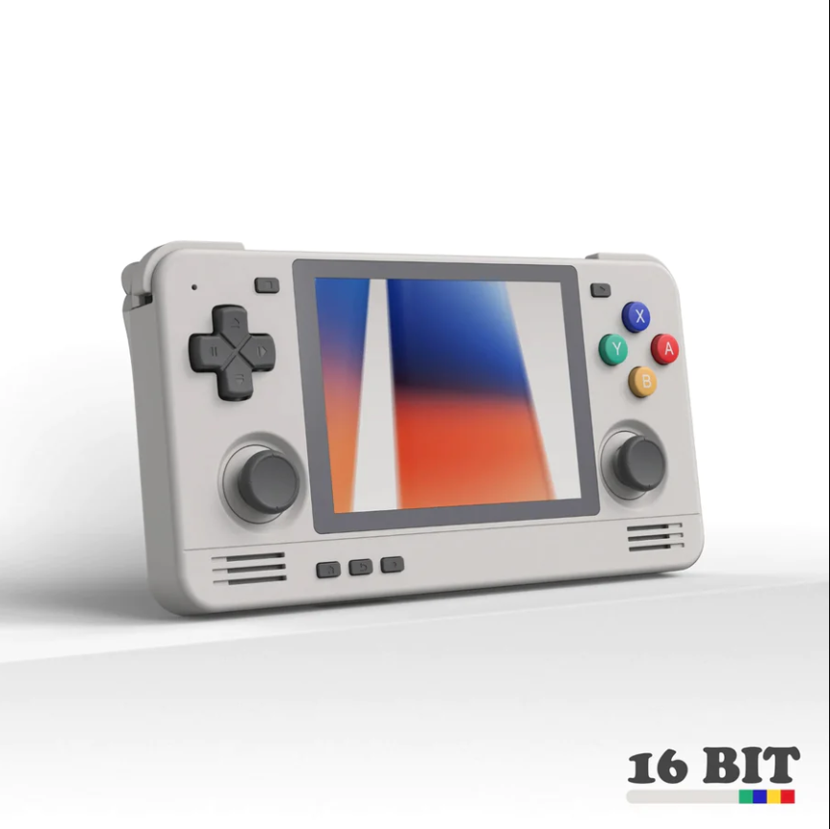
Superior Build Quality and Design
Anbernic RG405M has an aluminum alloy shell that not only feels premium but can also withstand wear and tear better than plastic-bodied alternatives. Constructed in this manner, this assures device survivability amidst daily drudgery when gaming in on-the-go situations. Additionally, it has a great design that ensures comfort even during long game marathons. The control buttons and sticks are ergonomically placed for a more functional yet attractive appearance.

Slide 3
Excellent Display and Audio
High-quality display is one of the defining characteristics of the Anbernic RG405M. Its 4-inch IPS screen delivers vibrant colors with sharp visuals, making old games look great. At 640x480 resolution, it manages to strike a perfect balance, maintaining old ones’ authenticity while providing much-needed clarity to present-day game players, hence ensuring both sides are fairly represented, neither overwhelming nor underwhelming each other. Ideally suited for most retro games due to its aspect ratio that minimizes black bars or stretching, elevating your visuals.
In addition to its excellent display, the RG405M also provides commendable sound quality. It has stereo speakers that ensure clear and loud reproduction of soundtracks as well as sound effects. This combination of visual and auditory senses creates an immersive game experience that is often missing from other handheld gaming consoles.

Slide 4
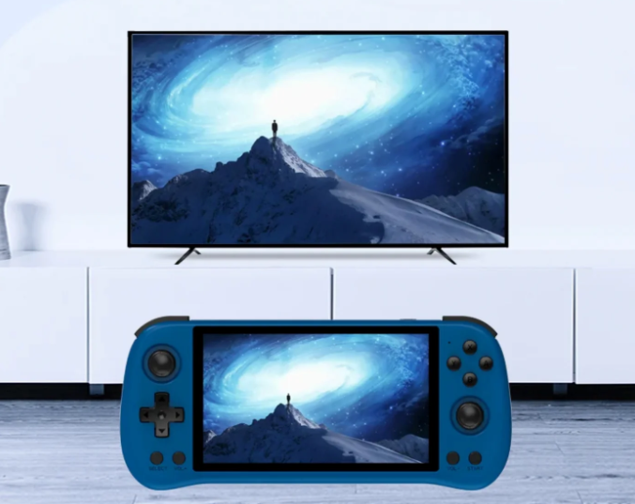
Vast Emulation Options
The extensive emulation capabilities of Anbernic RG405M make it one of the most popular consoles in the market. It can be used with various gaming systems like NES, SNES, Sega Genesis, and PlayStation, among others. The device runs smoothly even when playing more demanding games due to its powerful hardware. Gamers can, therefore, play different titles from different ages in only one gadget because it is versatile. Additionally, RG405M supports several emulator software applications, enabling users to modify their gaming experiences accordingly.

Slide 5
An Active and Supportive Community
Choosing a device with an active community and well-built support systems can greatly improve user experience. Anbernic RG405M benefits from an interactive group of users as well as developers who are passionate about it. In this form of assistance, the input provides you with a background where you can easily get help on troubleshooting, learn new tips and hints, and find plenty of resources to optimize your gadgets. Moreover, Anbernic is known for frequent firmware updates that enhance performance, fix errors, or bring additional capabilities. The commitment to continuing support means that the RG405M never gets outdated and remains fun even years after buying it.

Slide 6
Final Thoughts:
To summarize, the Anbernic RG405M is a top-tier retro handheld gaming device with exceptional build quality, excellent display and audio, wide emulation support, and strong community support. It offers a high-quality, versatile gaming experience, making it an excellent choice for both experienced gamers and curious newcomers.
Source URL: https://pocketgamesaus.weebly.com/blog/discover-anbernic-rg405m-the-ideal-retro-gaming-console

Slide 7
Thank You
Address: Sydney, NSW, Australia
Email ID: Sales@pocketgames.com.au
Website: https://pocketgames.com.au/

