Slide 1
Drug Rehabilitation Centre in Mumbai
I Care Foundation stands as a symbol of hope for those struggling with alcohol and drug addiction. Renowned for its holistic approach to recovery, the center offers a comprehensive program that addresses the physical, psychological, and social aspects of addiction.
I Care Foundation has earned its reputation as a leading alcohol and drug rehabilitation centre in Mumbai. If you or someone you know is struggling with addiction, the I Care Foundation can offer the hope and support needed to embark on the path to recovery.

Slide 2
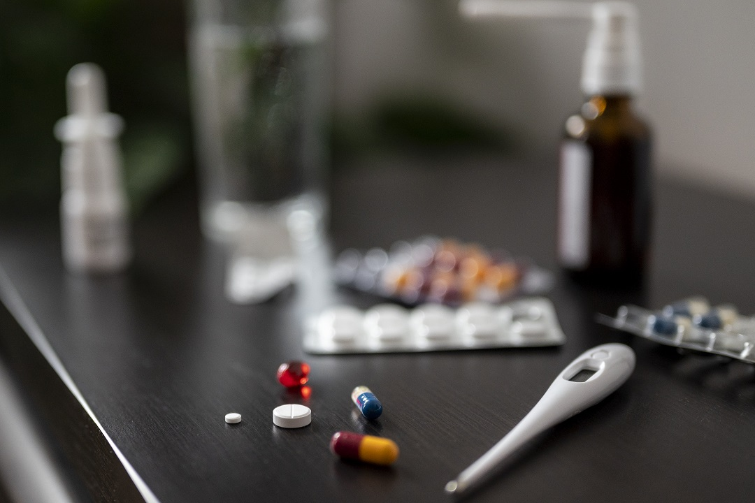
Company: I Care Foundation
Address: Soham Gardens, Bungalow No. 13, Ghodbunder Rd, Thane West, Mumbai, Maharashtra 400607
Website: https://icarefoundation.co.in/
Phone: 08693092000

