Slide 1





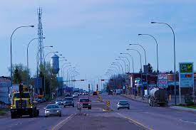
Claresholm Agencies

Slide 2



Background
In Claresholm, Alberta, Claresholm Agencies has been a reputable insurance firm for more than 30 years. As the only locally owned brokerage, they have a solid reputation for providing outstanding customer service, which guarantees client loyalty even when clients relocate.

Slide 3


SERVICES
PERSONAL INSURANCE
COMMERCIAL INSURANCE
Check out their different plans like Home & Contents Insurance and Auto Insurance. They're made to protect your important stuff. They have various options to keep safe what matters most to you.
They are committed to meeting the evolving commercial insurance needs of businesses in Southern Alberta, catering to both local enterprises and regional companies.

Slide 4


RECOMMENDATIONS
REGISTRIES
This place offers all the insurance services you need in one spot. They cover everything from registering your vehicle to getting birth certificates.
FARM INSURANCE
Claresholm Agencies has been serving the insurance needs of the farming community, deeply comprehending the distinctive elements of each farm operation.

Slide 5



Thank You
138 49 Ave West Claresholm, Alberta TOL OTO Canada
Phone: (403) 625-4488
Website: www.claresholmagencies.com
Email: info@claresholmagencies.com

