Slide 1
Explore the RG35XX Plus Game List: Top Picks and Classics
The RG35XX Plus is a standout handheld gaming console, popular for its ability to bring back the magic of retro gaming. With its sleek design and extensive library, it’s a favorite among gaming enthusiasts. In this blog, we’ll explore the RG35XX Plus game list, highlighting some top picks and timeless classics that make this console a must-have.

Slide 2
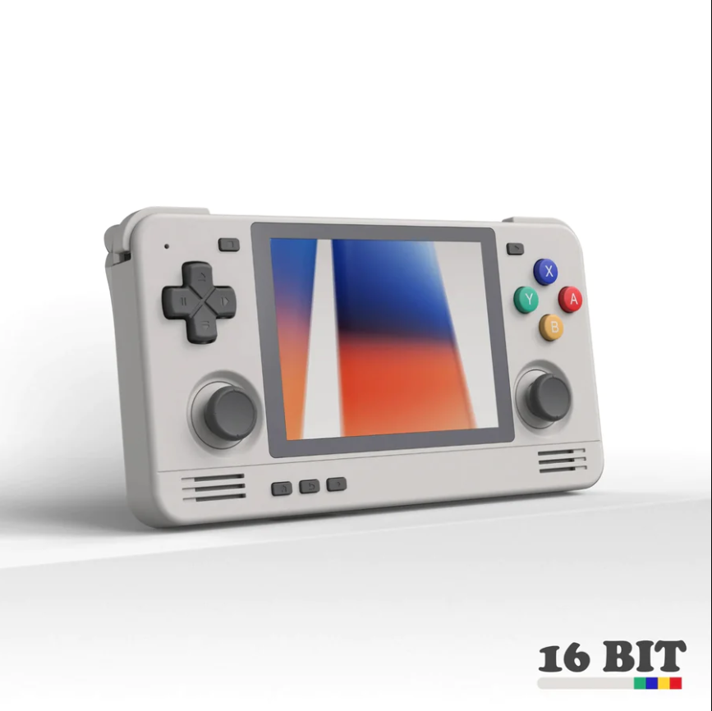
Why the RG35XX Plus is a Must-Have
Before diving into the games, let’s understand what makes the RG35XX Plus so special:
High-Resolution Display: Offers sharp, vibrant visuals that enhance the retro gaming experience.
Comfortable Design: Ergonomically designed for extended gaming sessions.
Wide Game Compatibility: Supports a vast array of games from various retro gaming systems.

Slide 3
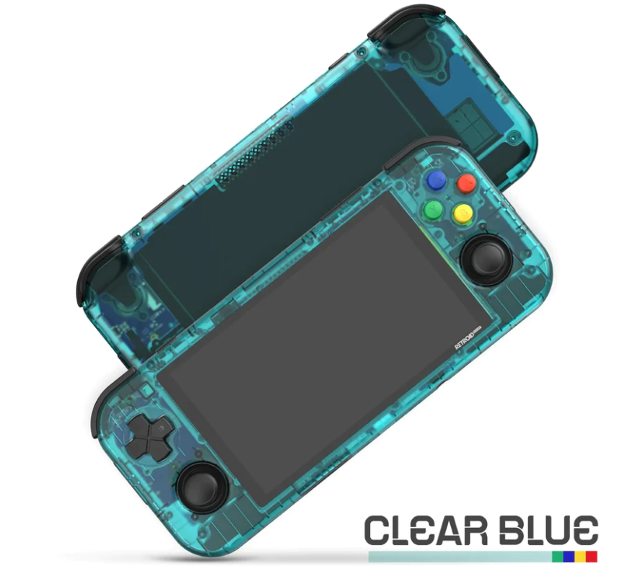
Top Picks from the RG35XX Plus Game List
1. Super Mario Bros
This iconic game is a staple in the RG35XX Plus game list. Navigate through the Mushroom Kingdom, dodge obstacles, and rescue Princess Peach in this timeless platformer.
2. The Legend of Zelda: A Link to the Past
Embark on an epic adventure in Hyrule. Known for its engaging story and challenging puzzles, this game is a highlight in the RG35XX Plus game list.
3. Sonic the Hedgehog
Experience the speed and thrill of Sonic the Hedgehog. This game offers fast-paced action and iconic levels, making it a top pick on the RG35XX Plus.

Slide 4
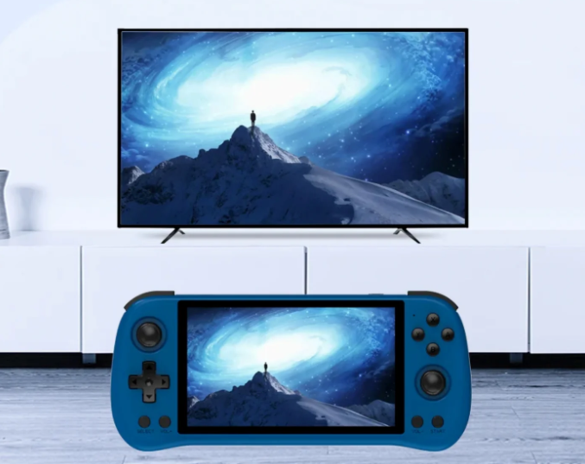
Hidden Gems on the RG35XX Plus Game List
1. Castlevania: Symphony of the Night
This action-adventure game blends exploration, combat, and RPG elements, creating an unforgettable experience on the RG35XX Plus.
2. Final Fantasy VI
Dive into a rich story with a diverse cast in Final Fantasy VI. This RPG is a classic and a highlight in the RG35XX Plus game list.
3. Contra III: The Alien Wars
Known for its intense action and difficulty, Contra III offers co-op gameplay and is a challenging gem on the RG35XX Plus game list.

Slide 5
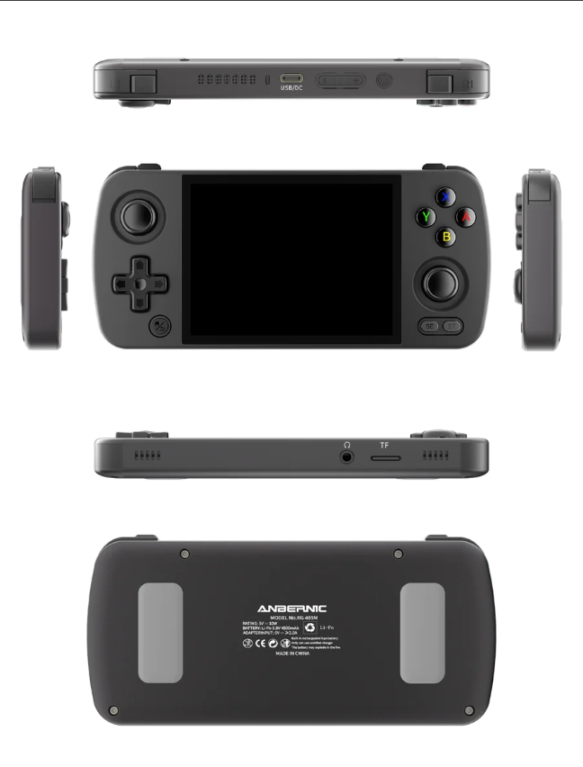
How to Access the RG35XX Plus Game List
The RG35XX Plus supports various emulators, allowing you to play games from systems like NES, SNES, Sega Genesis, and more. Here’s how to access these games:
1. Download ROMs: Ensure you own the original copies of the games you download.
2. Install Emulators: Follow guides to set up emulators on your RG35XX Plus.
3. Load Your Games: Transfer the ROMs to your console and start enjoying the extensive RG35XX Plus game list.

Slide 6
Conclusion
The RG35XX Plus offers an incredible gaming experience with its extensive game list, blending nostalgia with modern convenience. Whether you’re revisiting old favorites or discovering new ones, this handheld console is sure to provide endless hours of entertainment. Dive into the RG35XX Plus game list and enjoy the top picks and classics today!
Source URL: https://pocketgamesau.wordpress.com/2024/06/25/explore-the-rg35xx-plus-game-list-top-picks-and-classics/

Slide 7
Thank You
Address: Sydney, NSW, Australia
Email ID: Sales@pocketgames.com.au
Website: https://pocketgames.com.au/

