Slide 1
Leveraging WhatsApp CRM: 4 Key Benefits for Businesses
Businesses in this modern world are always searching for more and more effective ways to help them reach out to their customers. With the increasing use of messaging apps like WhatsApp, businesses have implemented Customer Relationship Management (CRM) strategies to create stronger customer relationships. For companies looking forward to enriching customer interactions and improving sales, WhatsApp CRM is a personalized approach to customer engagement through the messaging app.

Slide 2
1. Smooth Communication and Quick Replies:
One of the foremost important things to try to do when creating automated email campaigns is to segment your audience. WhatsApp CRM streamlines business interaction with its consumers, creating a real-time communication platform. Instant answering services and engaging messages on this app enable prompt replies to consumers’ requests, their problem solutions or support offerings. Unlike emails or phone calls, which may experience delays or limitations, WhatsApp allows instant direct communication.
2. Personalized Engagement and Targeted Marketing:
There are many benefits of having personalized interaction with clients through WhatsApp CRM. This allows firms to send messages or the right content to specific users based on their customer information. Businesses can use WhatsApp CRM to send tailored product recommendations, exclusive deals, or relevant updates, among others, for a true one-to-one conversation with their clients. This kind of personalization raises the level of involvement, enhances conversion rates, and strengthens brand commitment.

Slide 3
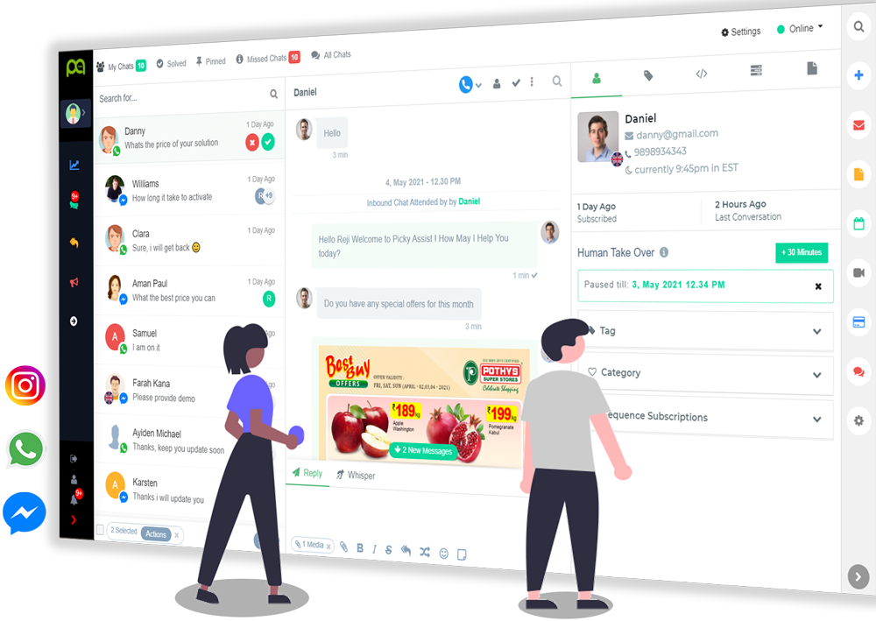
3. Enhanced Customer Support and Relationship Management:
WhatsApp CRM is an excellent tool for improving customer support and relationship management. Some of these features that facilitate this include automatic responses, chatbots and integration with CRM systems, making it easy for enterprises to receive and manage customer inquiries and keep records over time. For instance, if you have any technical problem solved, need assistance with a product or require post-purchase support services in any way possible, such as through the WhatsApp application, then this is the right channel to ensure your customers get this service right on time. Through stronger bonds and exceeding client expectations at all levels, enterprises can build better relationships with their clientele by using better tools available within the WhatsApp platform.

Slide 4
Increased Efficiency and Cost Savings:
More efficient and cost-effective business results can be obtained by introducing WhatsApp CRM. If customer communication is central to one platform, businesses could simplify their work, cut down on manual tasks, and better allocate resources. This particular service can be scaled through messaging templates, scheduling ability, and automation while reducing operational overheads. Additionally, using WhatsApp instead of traditional means like phone calls or postal mail is cheaper, hence saving costs. Enterprises’ employment of the WhatsApp CRM platform brings them improved efficiency levels and higher ROI rates, further sustaining their growth.

Slide 5
Conclusion
To sum up, WhatsApp CRM presents several advantages to businesses that seek advancement in customer engagement strategies. In other words, it enables companies to have personalized, seamless conversations with customers. Businesses using this app stand a chance of securing more sustainable, stronger customer relationships, culminating in better business outcomes.
Hence, to remain competitive in today’s market and deliver exceptional experiences that resonate with clients’ needs, companies must leverage these capabilities provided by CRM.
Source URL: https://pickyassistpvtltd.wordpress.com/2024/04/25/leveraging-whatsapp-crm-4-key-benefits-for-businesses/

Slide 6
THANK YOU
Address : TC 17/19-2 Near Jagathy Bridge Jagathy, Thiruvananthapuram Company Email : Sales@pickyassist.com
Main Telephone: +91-7715833404
Website : https://www.pickyassist.com/en/

