Slide 1
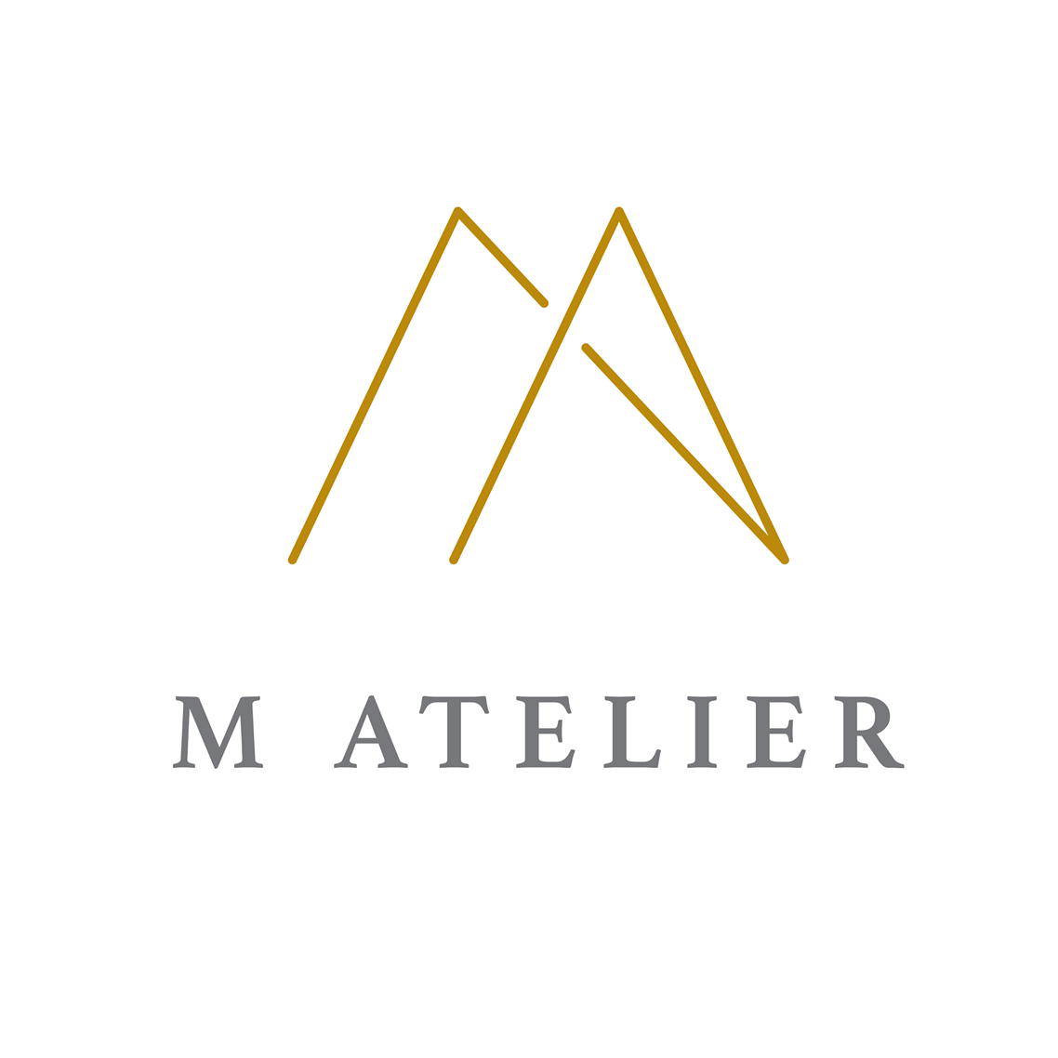
M Ateliers: The Best Home Interior Design Company in Singapore

Slide 2
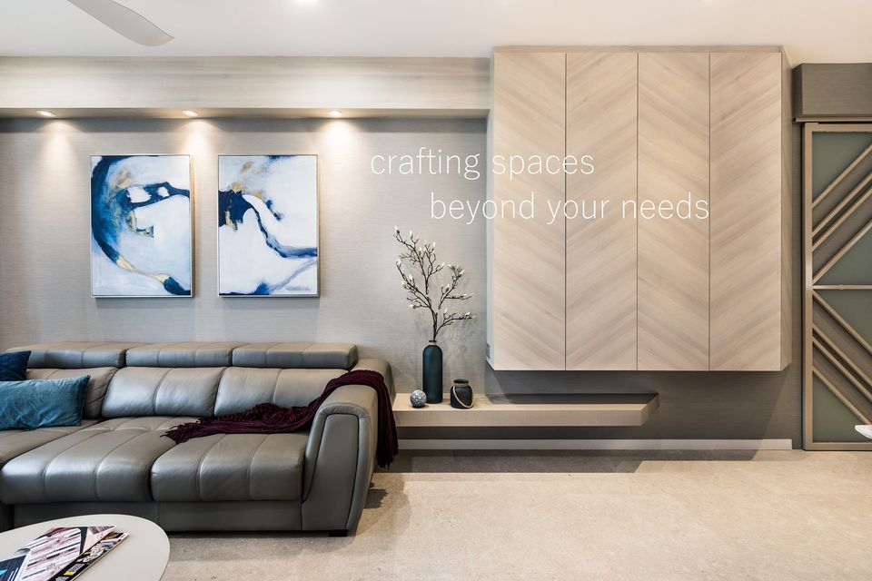
Are you looking to transform your living space into a haven of style, comfort, and functionality? Look no further than M Ateliers, the premier home ID Company Singapore. With a passion for creating stunning interiors that reflect your unique personality and lifestyle, M Ateliers combines creativity, expertise, and meticulous attention to detail to turn your design dreams into reality.
At M Ateliers, we understand that your home is your sanctuary, a place where you should feel relaxed, inspired, and truly yourself. That's why we take the time to listen to your needs, preferences, and vision for your space, ensuring that every design decision reflects your individual taste and enhances your daily life.
Our team of experienced designers is dedicated to bringing your ideas to life, from conceptualization to execution. Whether you're looking to refresh a single room or undertake a full-scale renovation, we have the skills and expertise to transform any space into a stunning masterpiece that exceeds your expectations.
One of the key factors that sets M Ateliers apart from other ID Company Singapore is our commitment to quality and craftsmanship. We work with only the finest materials and finishes, sourced from trusted suppliers and artisans, to ensure that every aspect of your design is of the highest caliber.

Slide 3
From luxurious fabrics and furnishings to bespoke cabinetry and fixtures, we spare no expense in creating interiors that are as beautiful as they are functional.
At M Ateliers, we believe that great design is about more than just aesthetics—it's about enhancing the way you live. That's why we prioritize functionality and practicality in every design, optimizing your space to suit your lifestyle and needs. Whether you require clever storage solutions, efficient layouts, or innovative design features, our team will work tirelessly to ensure that your home not only looks stunning but also functions seamlessly for you and your family.
When you choose M Ateliers as your Best Home Interior Design Singapore, you can rest assured that you're in good hands every step of the way. From the initial consultation to the final reveal, we'll guide you through the entire design process with professionalism, transparency, and open communication. Our goal is not just to meet your expectations but to exceed them, delivering results that inspire and delight for years to come.
So why settle for anything less than the Best Home Interior Design Singapore? Choose M Ateliers and elevate your living space to new heights of style, comfort, and sophistication. Contact us today to schedule your consultation and take the first step towards realizing the home of your dreams.

Slide 4
Contact Us:
M Atelier Interior Design
Visit Us:- https://m-atelier.sg
Email:- hello@m-atelier.sg
Phone No:- +65 87917688

