Slide 1

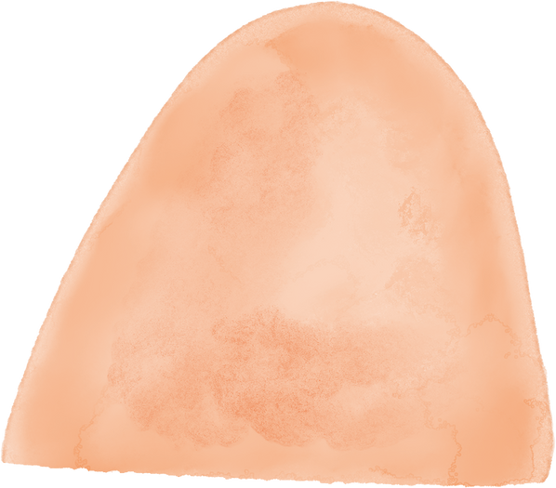
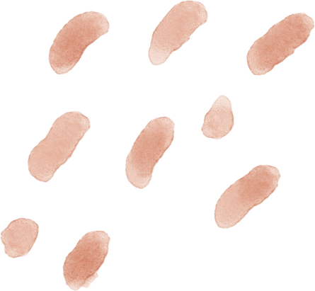


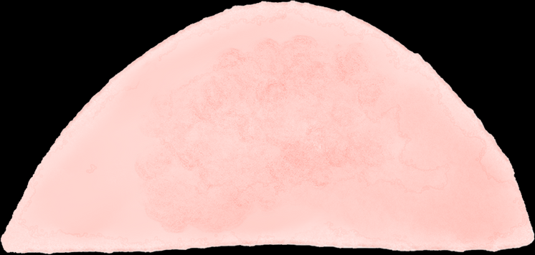
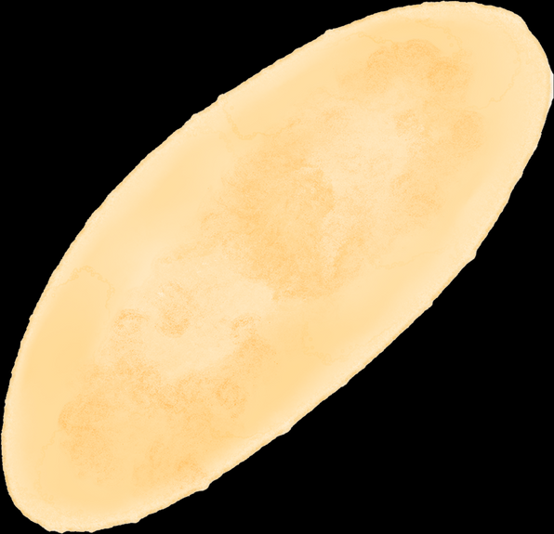
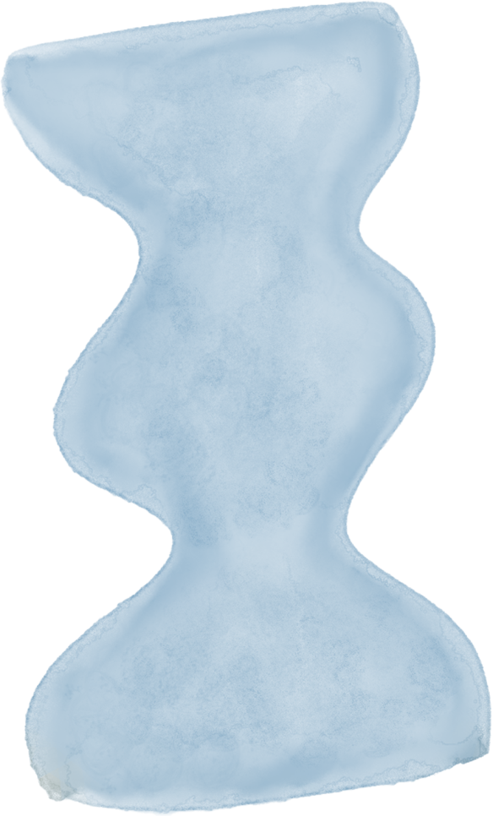






LAND O’ LAKES DENTAL

Slide 2
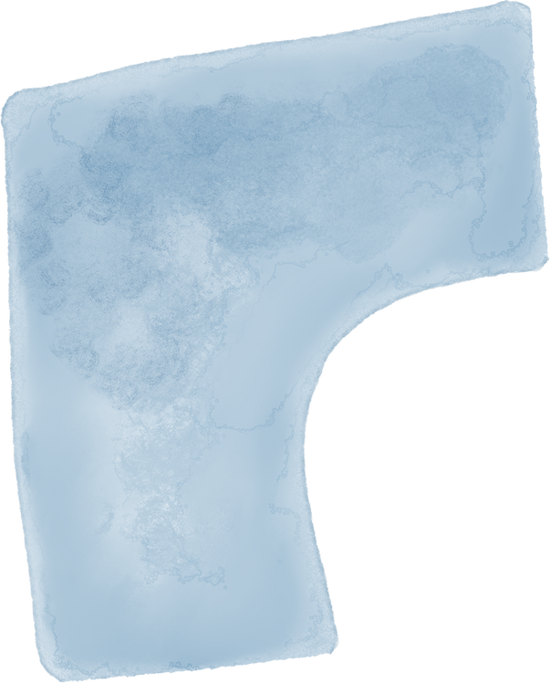
INTRODUCTION
One thing that sets Land O' Lakes apart is its persistent commitment to offering top-notch dental care. Highly qualified dentists with expertise in a variety of dental specialties, such as cosmetic dentistry, restorations, dental implants, and extractions, make up their team. Their dedication guarantees unmatched proficiency in handling various dental requirements, establishing Land O' Lakes as the top location for extensive and exceptional dental care.

Slide 3

SERVICES
Nitrous Oxide
They understand the concerns of individuals who may feel anxious about dental visits at our clinic. That's why they offer nitrous oxide as a choice. Their primary aim is to guarantee that patients can have worry-free and comfortable visits to their practice, and nitrous oxide is available to help induce relaxation during their time in the dental chair.
Implant Dentistry
Implants are frequently utilized to assist in the restoration of teeth that have experienced significant damage or are missing. This procedure typically involves implanting an artificial root made of titanium into the patient's jawbone, which eventually integrates with the bone. Following this, a dentist affixes an artificial tooth to reinstate a natural and visually appealing smile for the patient.

Slide 4
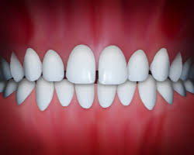
CROWN & BRIDGES
Uncover crowns and bridges that provide a genuinely natural appearance and sensation, ensuring your smile's complete contentment. Patients have the option to choose crowns and bridges, which are also referred to as fixed prosthodontics, for the efficient replacement of missing teeth and to offer support to neighboring teeth. The use of these dental fixtures can frequently act as a proactive step in preventing potential future dental issues.

Slide 5
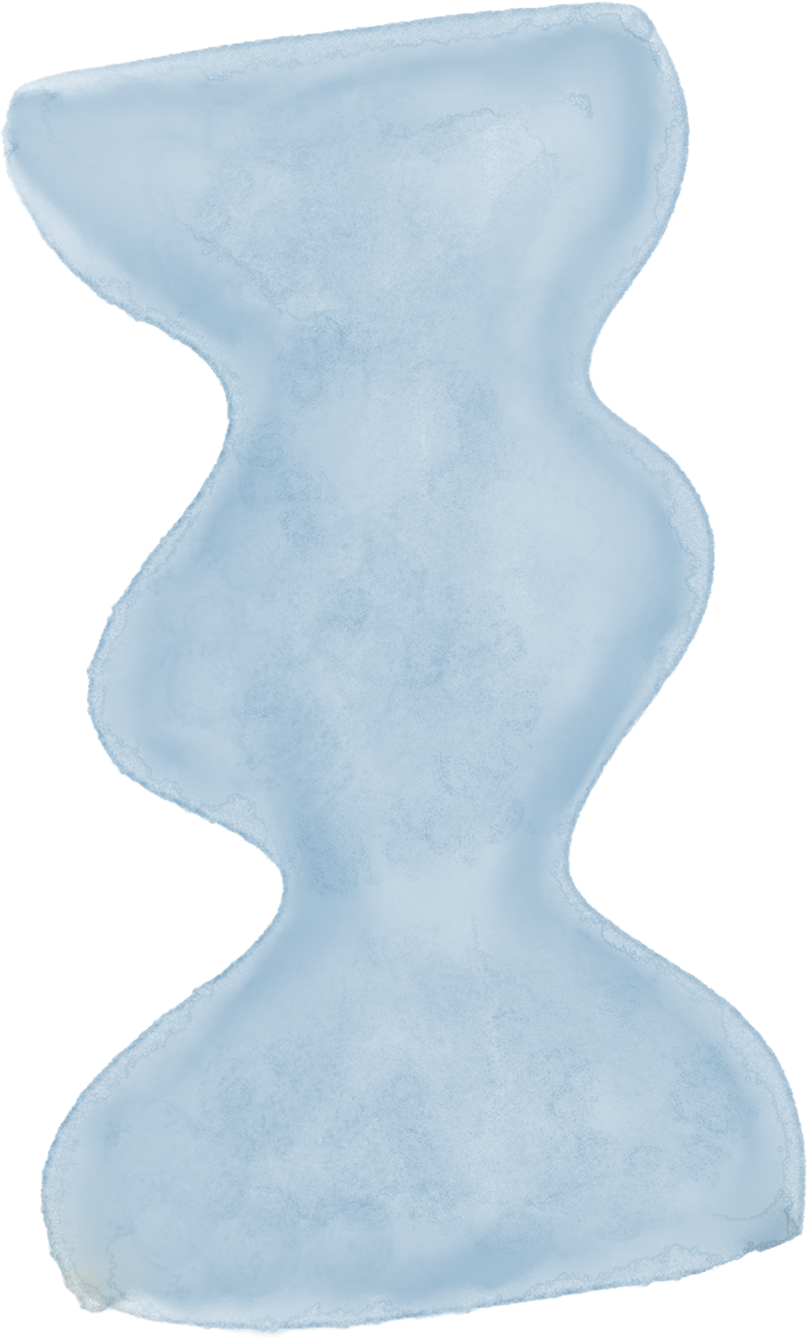


Professional Staff
At Land O' Lakes, their team is committed to addressing every patient's dental requirements, prioritizing a gentle, personalized, and enjoyable clinic experience. They strive to ensure that each visit is tailored to individual needs, fostering a comfortable and positive atmosphere for all their patients.

Slide 6
Contact them
Email: info@landolakesdental.com
Office: 1(587)-800-9900
2104A Land O’ Lakes Drive
Coaldale, AB
https://landolakesdental.com/

