Slide 1
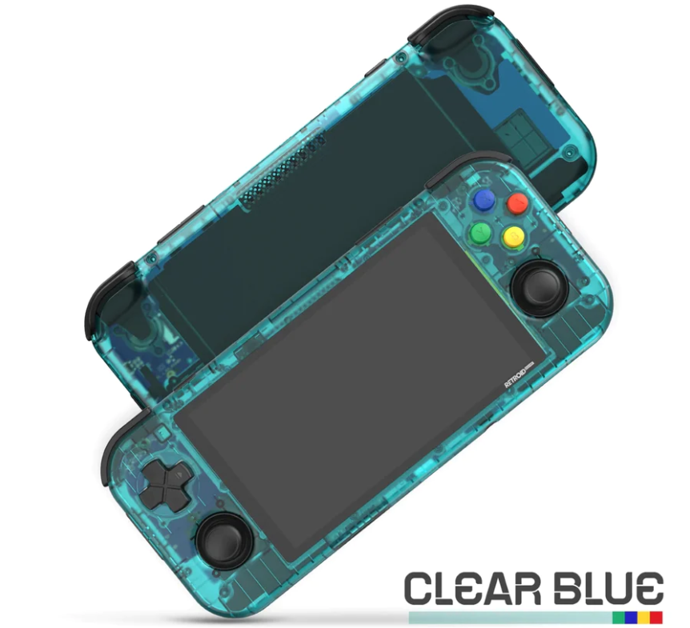
Reasons Why Retro Handheld Gaming Consoles are Still in Demand
Console-driven video games are a universal favorite, and buyers purchase them from different age groups worldwide. Some of these handheld gaming consoles come with retro themes, which has an especial demand in the market. Let us understand the reasons for this raging demand for retro handheld gaming consoles even now.

Slide 2
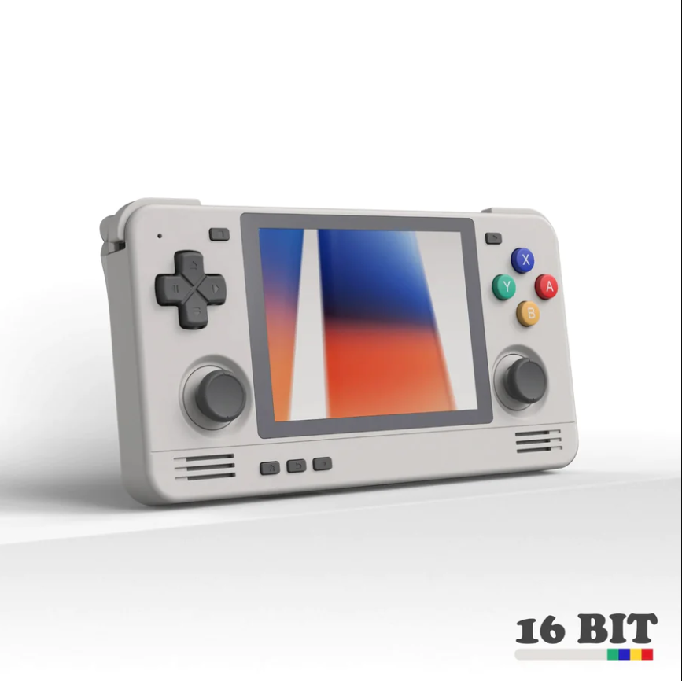
Diverse Game List
A single handheld gaming console can have diverse video games that are both engaging and interesting. The users of the retro handheld gaming console can get several choices of video games from a single gaming console to keep themselves engaged for a long time. The players can always switch to another game once they start feeling bored after playing a game type for a long time.

Slide 3
Simple Game Concepts
An elemental feature of the game list available in the classic consoles is the simplicity of the games. The games that are available in these consoles are interesting and engaging but at the same time, they are also easy to understand. Even if you are a new player, you can understand the game and start playing it quickly. You can improve your game after playing the concept for some time.

Slide 4
Simple Mechanism
The retro consoles have simple mechanisms. The buttons on the top surface of the console come with clear instructions for operations, which are easy to understand and practice. Players can easily understand and pick up the instructions on the console effectively for gaming purposes. These consoles are so easy to understand and follow that players of every age can use the gaming consoles and enjoy them optimally.

Slide 5
Compact and Lightweight Design
One of the main advantages of the best retro gaming console is its design. These consoles are no bigger than a mobile set and come with a cute, compact, and lightweight design. These consoles are easy to carry and will fit easily into any handbag or your shirt, trousers, and jeans pockets. This console runs on a cell battery and does not require any charging. You can always change the battery if the console requires a new set. The consoles are sturdy and have good usage longevity.

Slide 6
Cost-Effective Purchase
A vital reason, which explains the massive demand for retro handheld gaming consoles is their pocket-friendly prices. These classic gaming consoles have a highly reasonable and affordable price tag, which makes these gaming pocket consoles a raging success with a broad range of customers worldwide. Now, you can plan personal entertainment and fun with pocket-friendly means. These consoles are ideal for personal use, and they can also make perfect gifts for friends and family on any occasion. Order them online, pay online, and arrange to deliver them anywhere worldwide.
Source URL: https://pocketgamesau.blogspot.com/2024/03/reasons-why-retro-handheld-gaming.html

Slide 7
Thank You
Address: Sydney, NSW, Australia
Email ID: Sales@pocketgames.com.au
Website: https://pocketgames.com.au/

