Slide 1
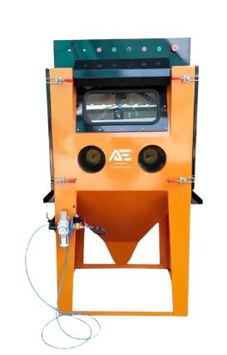
Shot Blasting Machine Ambica Enterprises
Enhancing Surface Finishing Solutions

Slide 2
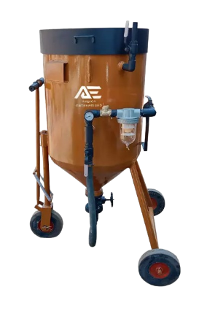
Welcome
Welcome to our presentation on Shot Blasting Machines by Ambica Enterprises. We are excited to showcase how our solutions can enhance your surface finishing processes
Design By – Nayan Singh

Slide 3
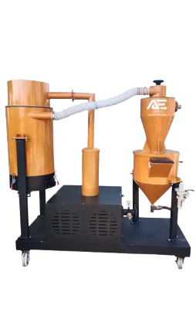
Introduction to Shot Blasting
Definition of Shot Blasting: Shot blasting is a surface preparation technique used to clean, strengthen, or polish surfaces by propelling abrasive materials against them at high speeds.
Importance in Surface Preparation: Shot blasting is crucial for achieving the desired surface finish, removing contaminants, and preparing surfaces for coatings or further processing.
Brief Overview of Process: Shot blasting involves propelling abrasive materials, such as steel shots or grits, using centrifugal force or compressed air onto the surface to be treated.

Slide 4
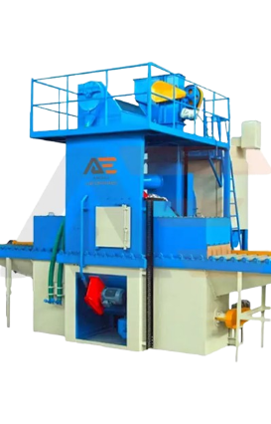
Types of Shot Blasting Machines

Slide 5
Wheel Blast Machines: Utilize centrifugal force to propel abrasive materials onto surfaces.
Tumble Blast Machines: Ideal for treating small or irregularly shaped parts by tumbling them in a chamber with abrasive media.
Air Blast Machines: Use compressed air to propel abrasives for surface treatment.
Table Blast Machines: Designed for treating flat or irregularly shaped parts placed on a rotating table within a blast chamber.

Slide 6
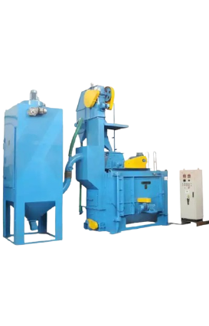
Components of Shot Blasting Machine
Blast Wheel
Cabinet or Chamber
Abrasive Reclaimer System
Dust Collector
Control System

Slide 7
Blast Wheel: Generates and propels abrasive materials onto the workpiece surface.
Cabinet or Chamber: Enclosed space where the blasting process occurs.
Abrasive Reclaimer System: Collects and recycles abrasive materials for reuse
Dust Collector: Removes dust and debris generated during the blasting process.
Control System: Manages and regulates the operation of the shot blasting machine.

Slide 8
Working Principle
Abrasive Propulsion:
Dust Collection:
Abrasive materials are propelled at high speeds onto the surface to be treated.
Dust and debris generated during the process are captured and removed to maintain a clean working environment.
Abrasive Recovery:
Surface Impact:
Used abrasive materials are collected, cleaned, and recycled for reuse.
The abrasive particles impact the surface, removing contaminants and imperfections.

Slide 9
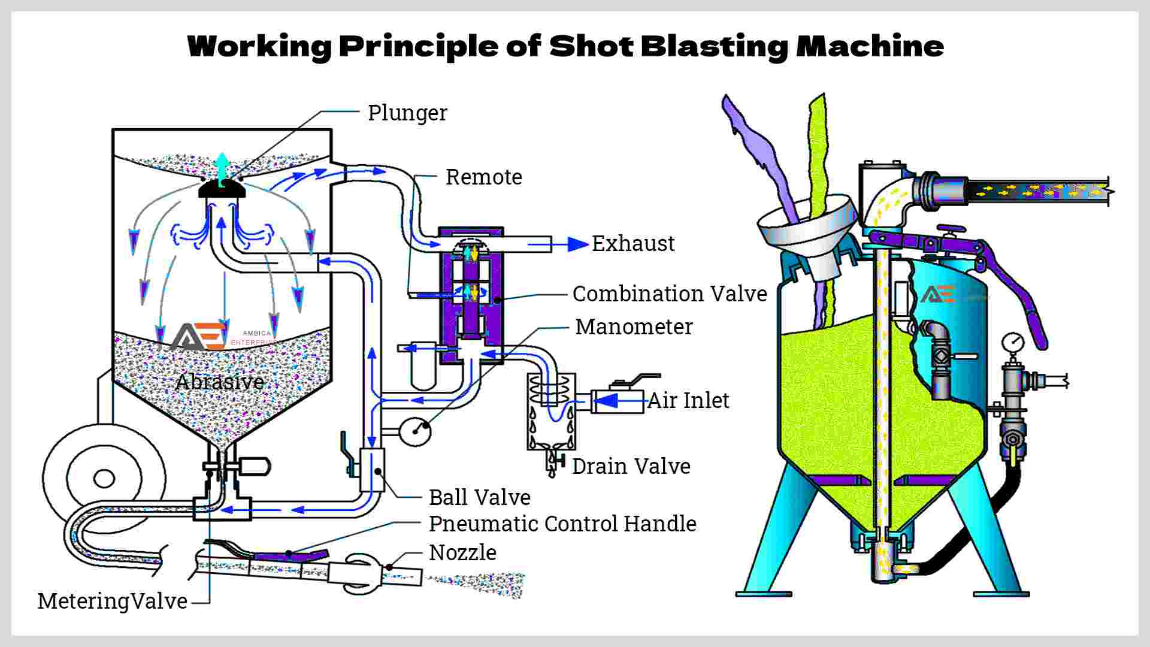
Working Principle

Slide 10
Applications of Shot Blasting

Slide 11
Applications
Automotive Industry
Aerospace Industry
Used for cleaning and preparing automotive components such as chassis, engine parts, and wheels.
Critical for surface preparation of aircraft components to meet stringent quality and safety standards.
Construction Sector
Prepares surfaces for coatings or repairs in construction projects such as bridges, highways, and buildings.
Metal Fabrication
Foundries
Removes scale, rust, and other surface contaminants from metal parts for welding, painting, or finishing.
Prepares molds, castings, and other foundry components for further processing or finishing.

Slide 13
Advantages of Shot Blasting
Efficient Surface Cleaning: Removes contaminants, rust, scale, and old coatings effectively.
Improves Adhesion for Coatings: Creates a roughened surface profile that enhances the adhesion of coatings.
Increases Surface Hardness: Shot peening can induce compressive stress, improving the fatigue life and durability of components.
Cost-effective Solution: Provides a fast and efficient method for surface preparation, reducing overall processing time and costs.

Slide 14
Considerations Before Choosing a Shot Blasting Machine
Type of Material to be Processed: Consider the material composition, size, and shape of the parts to be treated.
Surface Finish Requirements: Determine the desired surface roughness, cleanliness, and uniformity.
Throughput Capacity: Evaluate the required processing capacity in terms of parts per hour or square meters per hour.
Floor Space Availability: Consider the available space for installing and operating the shot blasting machine.
Budget Constraints: Determine the budget allocation for the purchase, installation, and maintenance of the equipment.

Slide 15
About Ambica Enterprises
Ambica Enterprises is a leading provider of surface finishing solutions, specializing in shot blasting machines and related equipment.

Slide 16
Expertise in Surface Finishing Solutions
With 15+ years of experience and expertise, we offer innovative solutions tailored to meet our customers' specific requirements.

Slide 17
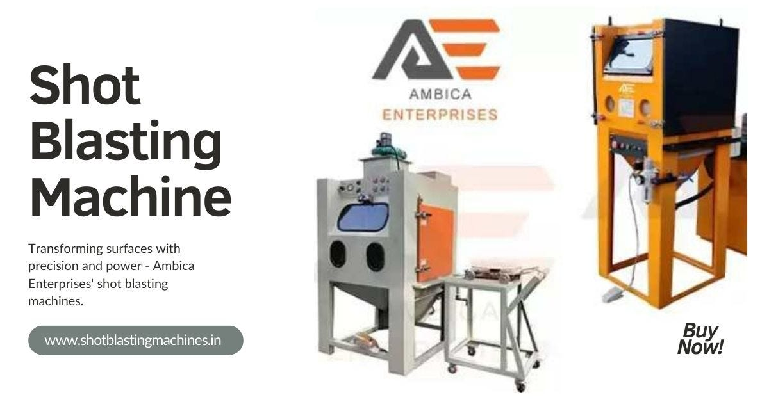
Range of Shot Blasting Machines Offered
Our product portfolio includes a wide range of shot blasting machines suitable for various industries and applications.

Slide 18
Product Portfolio
Wheel Blast Machines
Air Blast Machines
Tumble Blast Machines
Table Blast Machines
Sand Blasting Machine
Shot Blasting Machine
Abrasive Blasting Machines
Grit Blasting Machine

Slide 19
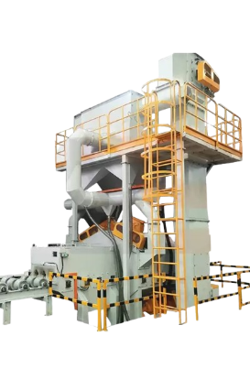
All Product

Slide 21
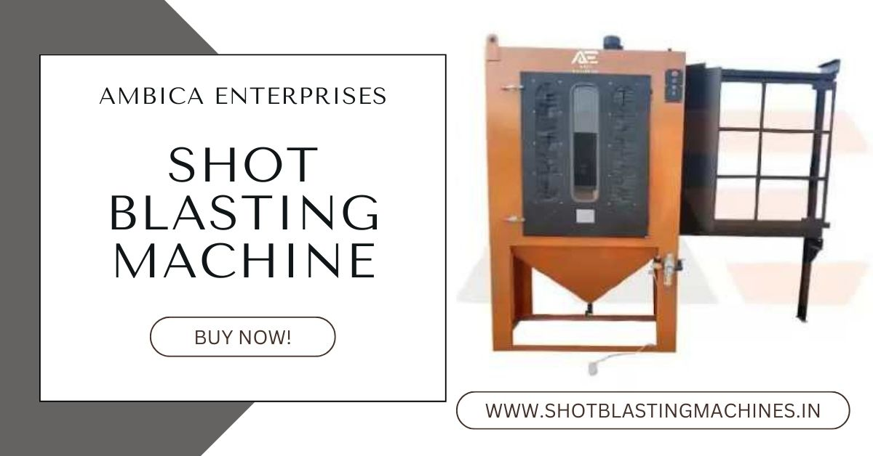

Slide 23
Contact Information
Address: Plot No. 324-25, 378-79-80, khasra No. 9/4, Shree Yade Gaun, Near Banar Ring Road, Jodhpur, Rajasthan, India, Pin Code – 342027
Phone Number: +91-9653765900
Email: inquiryi46@gmail.com
Website 1: www.shotblastingmachines.in
Website 2: www.shotsblastingmachine.com

Slide 24
Thanks!
Do you have any questions?
inquiryi46@gmail.com +91-9653765900
https://www.shotblastingmachines.in/
Thank you for taking the time to learn about Ambica Enterprises and our shot blasting solutions. We are here to answer any questions you may have.

