Slide 1
Should you choose the services of an experienced Chiropractor After Car Accident?
Integrated Health Solutions

Slide 2
Imagine yourself being the victim of a car accident. Often the injuries are much more than physical ones. Many complain of tense neck muscles, stiffness, etc.
Choosing the right Chiropractor After Car Accident can help to control the issues. These ensure that the problem in the neck tissues is managed. Minus this, these become inflamed which results in a limited range of movements.

Slide 3
Why Choose a Good Chiropractor After a Car Accident?
Auto injuries and whiplash effects can fling your head back after an accident. Within seconds you can end up with damage to your muscles, ligaments, etc.

Slide 4
Whiplash injuries often extend beyond mere soreness. Selecting the best Chiropractor After Car Accident can help to control the affects of the same like –
Neck pain,
Headaches,
Shoulder pain,
Upper back pain,
Reduced neck mobility, etc.

Slide 5
With a good Chiropractor in Carmel IN, you can expect non-invasive treatments for all the above issues.
You may choose to start with multiple treatments per week for a month or a few weeks. This therapy is covered by leading insurance plans.
As symptoms improve, the visits can be settled into a monthly session for assessment.

Slide 6
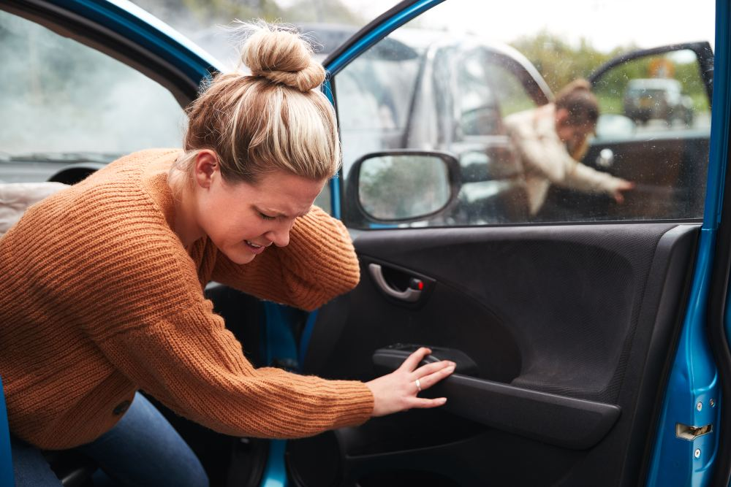
Benefits of choosing Chiropractor After Car Accident

Slide 7
By choosing the best Chiropractor After Car Accident, you can expect the following benefits –

Slide 8
Helps to control inflammation
Inflammation can result from physical injury. Although some amount of such inflammation is good and indicates that the body is attempting to recover itself. However, too much inflammation can cause discomfort, stiffness and pain.
When the chiropractor treats your spine, they help to realign your spinal cord. Your body may respond by cutting back on the cytokine levels. This can lower the inflammatory response in your body.

Slide 9
Minimize pain
On receiving chiropractic adjustments, you can also control the pain throughout the body.
During spinal manipulations, your body naturally releases pain relievers. Studies show that Chiropractic care can help to improve neurotensin and cortisol levels.

Slide 10
Improve your health and body movements
When you are injured in a car accident, your body may lose its flexibility. Loss of flexibility can be due to misaligned joints in the spine, development of a scar tissue or inflammation.
Choosing the right Chiropractic care can help to restore the range of motions by mobilizing your spine and returning the same to the proper alignment.

Slide 11
Reduce scar tissue
When the muscles and tendons are damaged, the body attempts to heal these by forming a scar tissue. This can also result in long-term pain or stiffness.
Often the tissue heals on its own and can function like a normal one. However, if it causes discomfort then Chiropractors can choose specific techniques to break the same.

Slide 12
Experience non-invasive treatments
Many people wish to avoid surgery after a car accident. However, waiting too long can result in surgery.
With the Chiropractic help, you get non-invasive treatments that help to align the same without surgical intervention.

Slide 13
Enjoy personalized treatment plan
Chiropractors help you to get a personalized treatment plan. This is done after careful assessment of your injuries.
Business mail: amie@ihsindy.com
Address: Located in 6330 E 75th St #124, Indianapolis, IN 46250
+1 317-449-2020
https://ihsindy.com/

