Slide 1
Why study in Australia?
Australia is home to 43 universities in total, with 40 Australian, two international and one private university
Eight Australian universities placed in the top 100 in the latest QS World University Rankings(Go8)
Australia offers admissions in three intakes – Feb, July*, Nov
Admission process is very simple and transparent - 60% and above in Bachelors + English proficiency test (IELTS/PTE/TOEFL)
Students can get scholarship up to 35%
Career gap more than 6 months is not accepted.
Students can work 48 hours per fortnight with a pay of 23.23 AUD per hour
Students can get stay back permit up to 5 Years based on Regions
Students with degrees in areas of skill shortages will have an extra 2 years to stay and work in Australia

Slide 2
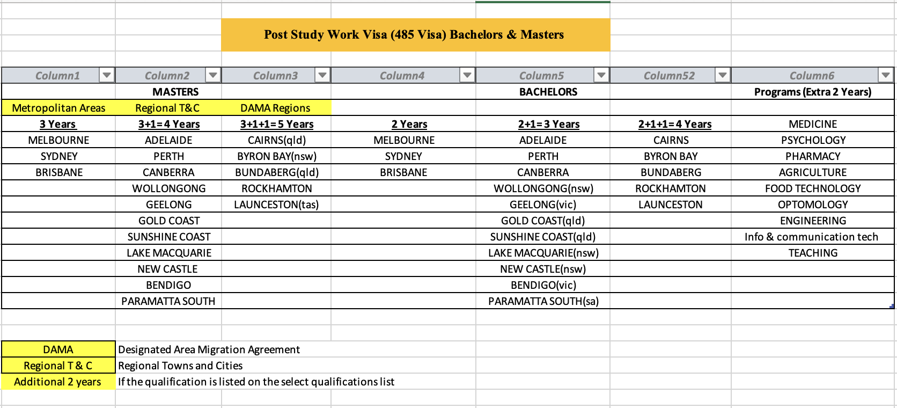

Slide 3
Application Process
Basing on your profile select your course and University
Gather all your required documents(academics - 10th, +2, graduation transcripts, CMM, PC, English proficiency tests, experience documents if any, passport(front & back))
Receives an offer letter from university (either unconditional or conditional offer)
Arrange financials (Funds & Income) – (Living cost 21,041/yr + travelling cost 2,000 + tui fe 22L(approx))
Funds (30 - 35 lakhs) Income ( 10 LPA or above)
- Education Loan - Employee (Form 16 + B. S)
- Mortgage Loan - Business (IT returns(2Yrs) + B.S)
- Fixed Deposit (6M old) - Agriculture( M-seva income cer)
- Savings A/C (6M old) - Rental Agreements + B. S
Note: Sponsorship ( parents – 70% min + other relation 30%)
GTE ( Genuine Temporary Entrant) interview
Payment of 1 Sem fees + OSHC ($1400(77 K) - 2 Yrs)
Receives eCOE ( Confirmation of Enrollment) from university
Complete medical tests from authorized centers
Application for visa (Submit all the documents from academics to medical certificates) visa cost
$715(40,000)
visa Application can take from 1 – 45 days

