Slide 1
Things you can expect from Holding Companies Ireland
Amstrow

Slide 2
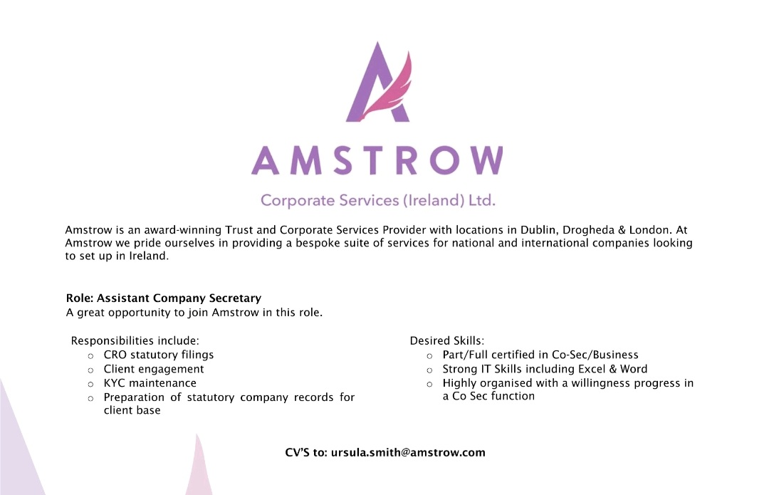
The country has become a massive center point for holding organizations because of its good business climate, the essential area inside the European Union, and alluring expense impetuses. Holding organizations in Ireland act as parent enterprises that own portions of different organizations, frequently utilizing the nation’s administrative and financial benefits.

Slide 3
Tax Proficiency
One of the essential reasons organizations lay out holding organizations in Ireland is the country’s worthwhile tax assessment system. Ireland offers a competitive corporate expense rate – the lowest in the EU. The Holding Companies Ireland leverages the factor for sustainable businesses. Besides, Ireland has an exhaustive organization of twofold tax collection settlements with more than 70 nations, limiting the risk of twofold tax assessment on cross-line exchanges. The nation additionally gives significant expense exclusions on profits from auxiliaries, capital increases charge exceptions on the removal of qualifying auxiliaries, and an alluring licensed innovation system.

Slide 4
Key Area and Market Access
Ireland’s enrollment in the EU furnishes holding organizations with consistent admittance to the EU’s single market. The market has roughly 450 million shoppers. This entrance is especially beneficial for organizations hoping to extend their tasks and lay out a huge presence in Europe. The country’s industries offer strategic advantages, with advanced transport connections to other significant European urban communities and markets.

Slide 5
Good Administrative Climate
Ireland is eminent for its support of business administrative climate, which works on the method involved with setting up and overseeing holding organizations. The nation offers an efficient organization enrollment process, combined with vigorous lawful insurance for investors. Irish corporate regulation is aligned with EU guidelines, guaranteeing consistency and encouraging certainty among global financial backers. Furthermore, the country’s custom-based regulation general set of laws is recognizable to organizations from other precedent-based regulation purviews. There are excellent facilities for a Virtual Office Setup in Dublin.

Slide 6
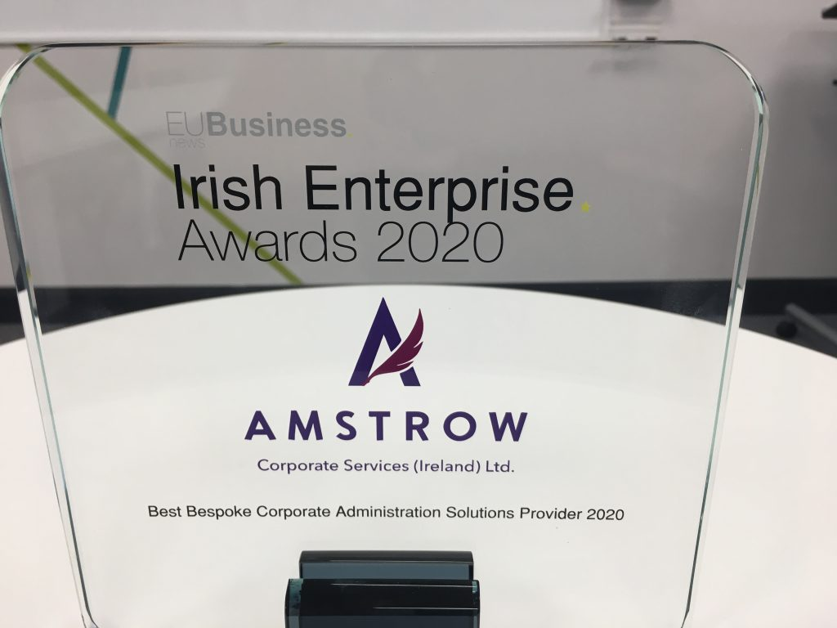
Talented Labor force
The country flaunts an exceptionally taught and gifted labor force, making it an appealing objective for organizations requiring particular abilities. The nation is competitive in schooling – in fields like innovation, finance, and pharma – fundamental for holding organizations working in different areas. The accessibility of a gifted labor force upholds the development and maintainability of holding organizations in Ireland, empowering them to accomplish functional proficiency and advancement.

Slide 7
Robust Financial System
The country has an advanced monetary administration area, which is fundamental for the fruitful activity of holding organizations. Dublin, the capital, is a significant financial center, facilitating various worldwide banks, venture companies, and insurance agencies. This monetary biological system gives holding organizations admittance to many financial products and services, including banking, speculation the executives, and corporate money arrangements. A developed financial sector ensures that holding organizations can proficiently address monetary tasks and access worldwide capital business sectors.

Slide 8
High-level Framework
Its high-level framework upholds the smooth activity of holding organizations. Ireland has an exceptionally evolved media communications organization, with boundless admittance to the high-velocity web, which is critical for current business tasks. Also, Ireland has kept up with transport foundations, including air terminals, ports, and street organizations, working with simple development of merchandise and individuals. This vigorous foundation supports the productivity and network of holding organizations, upgrading their capacity to direct business globally.

Slide 9
Contact hre :-
https://www.facebook.com/iShackDigital?ref=ts
https://twitter.com/iShackDigital
https://www.linkedin.com/company/ishack-technology-solutions?trk=company_logo
https://www.youtube.com/user/ishackdigital
E-mail: info@ishack.co.za
Quick Contact: 0828508289

