Slide 1

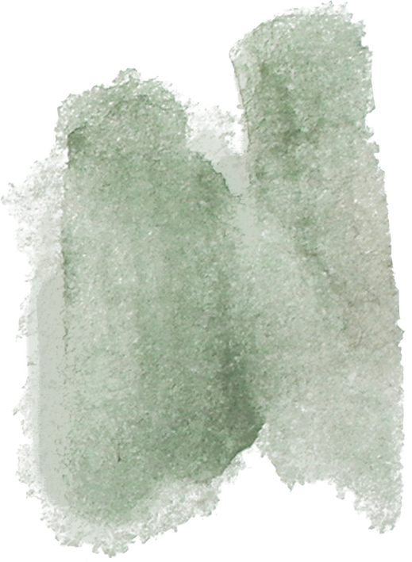
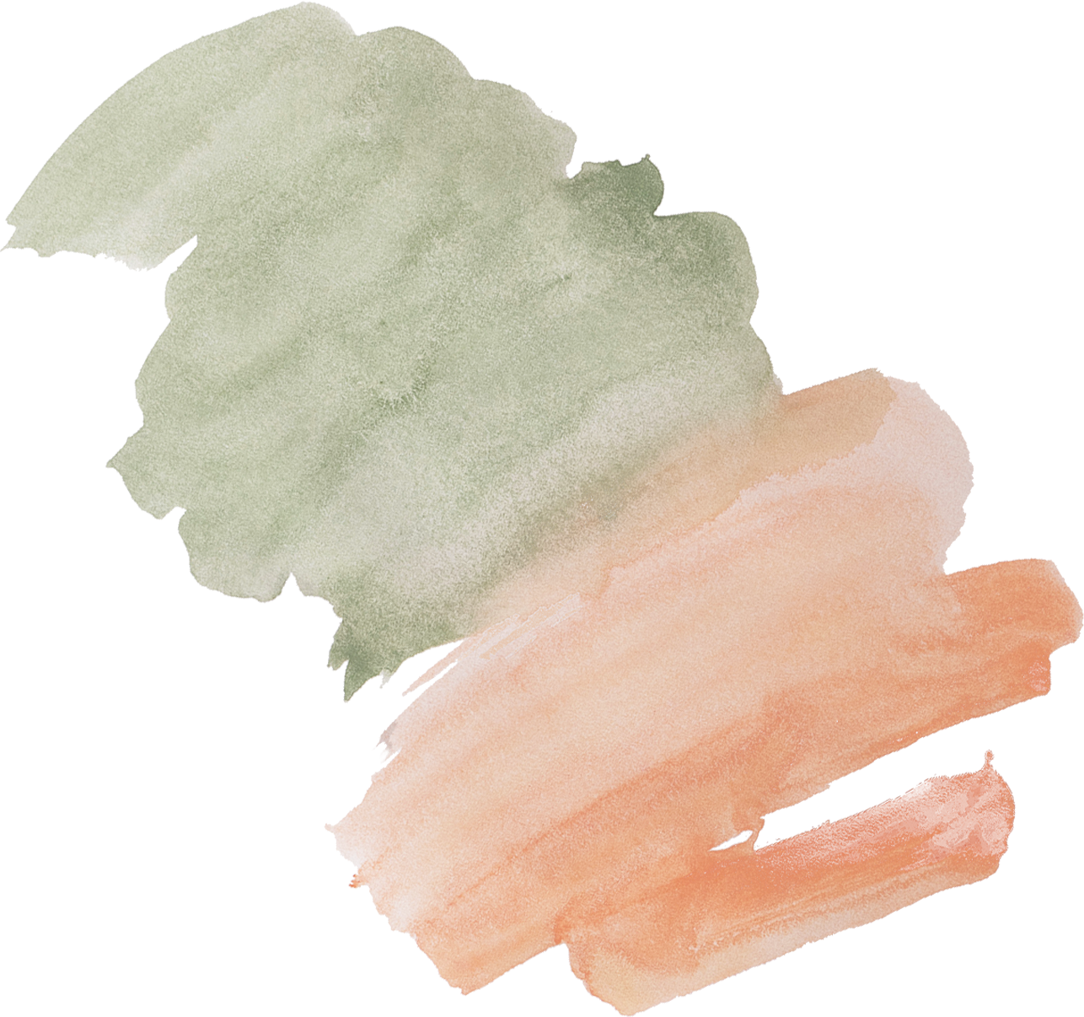


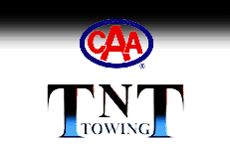
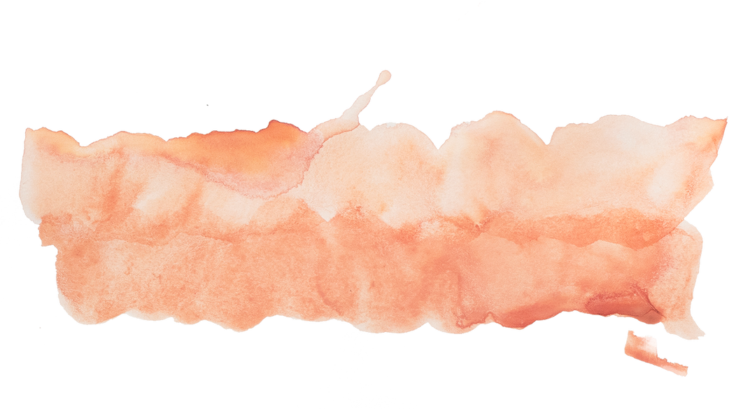

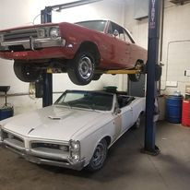

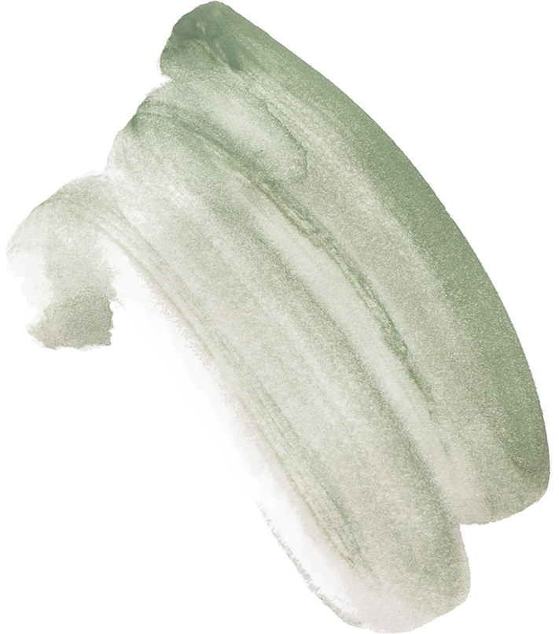

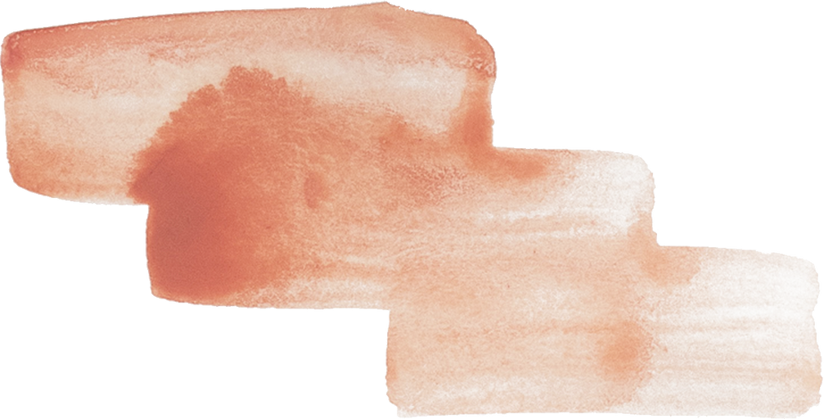
TNT TOWING

Slide 2
Introduction
TNT Towing and Salvage Disposal has been a top towing business in Alberta for more than 49 years, dedicated to helping the community. They are experts in towing commercial vehicles of all kinds and specialize in a wide range of services. TNT Towing is the dependable and first option for all towing needs, whether you need auto wreckers or AMA tow trucks in Lethbridge, Alberta.

Slide 3




SERVICES
TNT Towing has all the tools necessary to handle a variety of towing needs. Their big fleet enables them to handle light-duty to heavy-duty towing jobs, including everything from golf carts that won't start to boats that are stranded in lakes and large semi-trucks that need help getting out of ditches. Their competence highlights their readiness and skill by ensuring reliable and quick transportation to any location.

Slide 4

LIGHT TOWING
With a varied fleet of trucks at their disposal, they are ready to help with minor towing needs. Whether your car has trouble starting or is in an accident, you can rely on them for safe travel. Their knowledgeable staff and top-notch tools guarantee hassle-free towing, putting your car's safety first at all times.

Slide 5

﻿THANK YOU
https://tnttowing.ca/
218, 36th Street North, Lethbridge (Alberta) T1H 3Z7
Phone: (403) 327 4279
Email: tnttow1@telus.net

