Slide 1

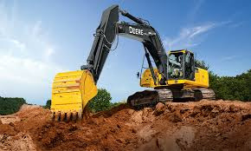
WELCOME TO DUTCHIE DIRT MOVING

Slide 2
Overview
Dutchie Dirt Moving Ltd. provides services to southern Alberta's County of Lethbridge. Dutchie has demonstrated that it is capable of handling any earth-moving requirement thanks to its extensive inventory of excavation equipment and on-site gravel pit.

Slide 3
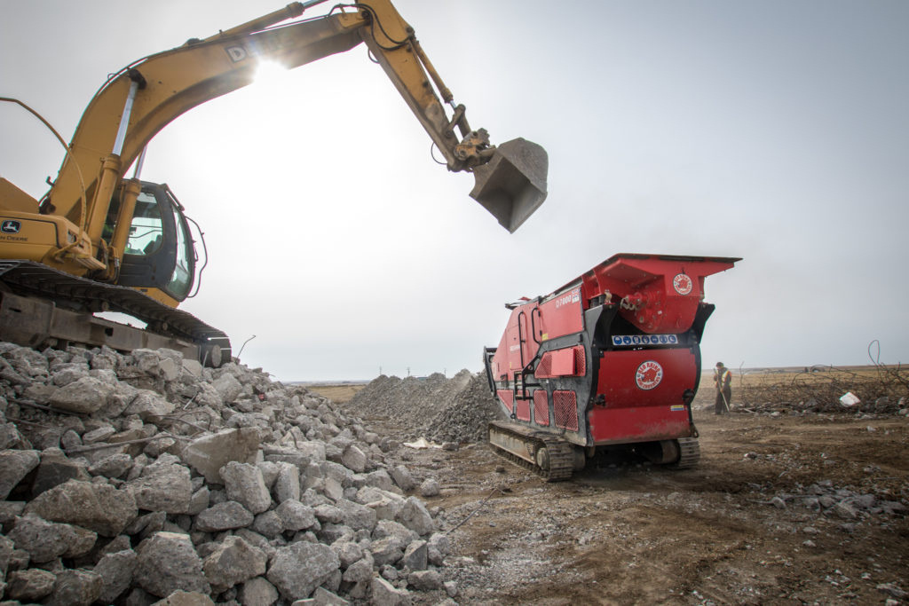
Services
EXCAVATION
TRUCKING
In Lethbridge, Alberta, Dutchie Dirt-Moving has worked on a wide range of excavation jobs.
Dutchie Dirt-Moving offers a range of trucks to meet the different trucking requirements of its clients.
GRAVEL
CONCRETE CRUSHING
Additionally, Dutchie Dirt Moving owns a gravel quarry that is equipped to handle all of its needs for sand and gravel.
A Red Rhino Mini Crusher has been added to Dutchie Dirt Moving's collection. They have the machinery to handle both large and little volumes of crushing, so no project is too big or small.

Slide 4

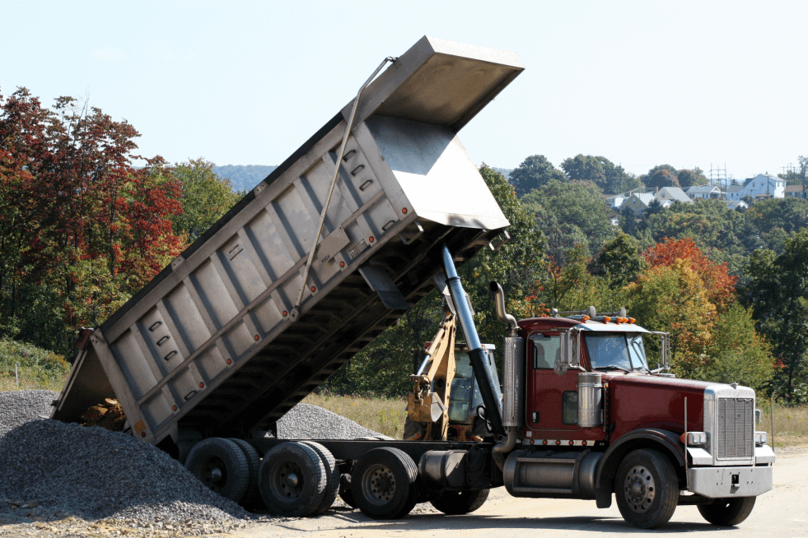
Contact
  Call + 403 738-4033
  Address: Box 120 Turin, AB T0K 2H0
  Email: office@dutchiedirtmoving.com
  Website: https://dutchiedirtmoving.com

